Slide 1

The Role of TRAs in Early Embryonic Development
Final project presentation
Group 4: Amena Elmaadawy, Mariam Hassan, Nina Droste, Aleksandra Dohren
Supervisors: Dr. Maria Dinkelacker, Ian Fichtner
Molecular Biotechnology B. Sc, Ruprecht Karls University of Heidelberg

Slide 2
Large changes in gene expression between four- and eight-cell stages are linked to the expression of TRAs and thus to tissue development
Notes:
True, 4-8 cell stage ist overregulated: DGE, unsignifikant unsignifikant sagt niht, dass es keine changes gibt.
Tissue development: Wir haben getestet GSEA 4/8/ all show HYPOXIA Pathways, and no tissue development pathways
There larges change in gene exressioen do not indicate tissue development. Therefore TRA expression is not mecessarly liked to tissue development

Slide 3

Sub questions
Is the greatest TRA expression found between the fourth and eighth cell stage?
Is TRA expression in bovine comparable to TRA expression in mouse?
Which is the earliest biological function expressed by those genes?
Notes:
Yes, we found that with DGE -> Graphen tabellen etc.
We dont have bovine TRA data sets to match but we compared pathways that are significant in either bovine or mouse and we didnt find matching ones. With given tra table bovine we are able to identify TRA Genes that are behaving similarly in both, mouse and bovine. More time and resou
We found pathways -> Hypoxia

Slide 4

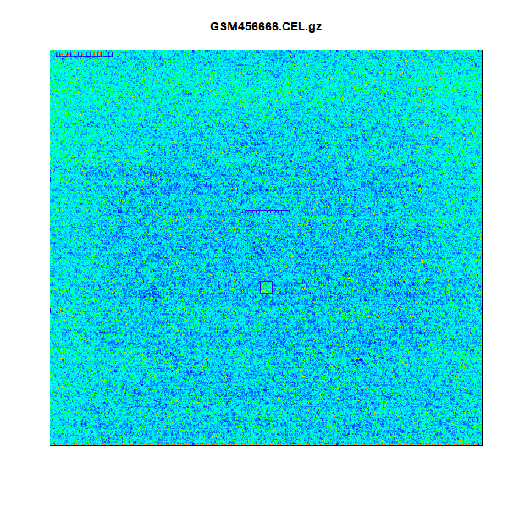
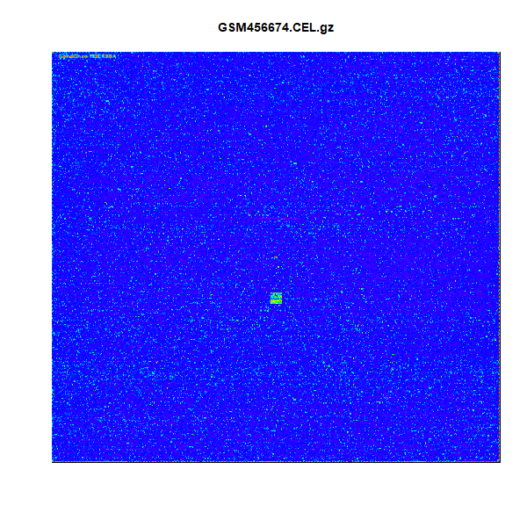
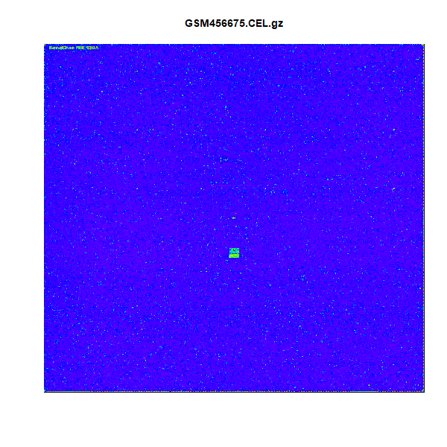
Quality control of chips: Single chip control

Slide 5
Mouse DGE results: Volcano plot

Slide 8
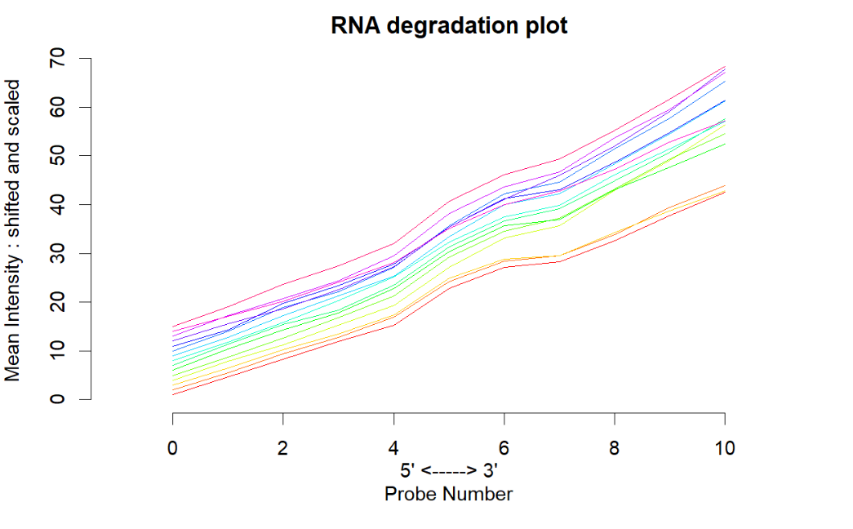
Quality control: RNA degradation

Slide 9
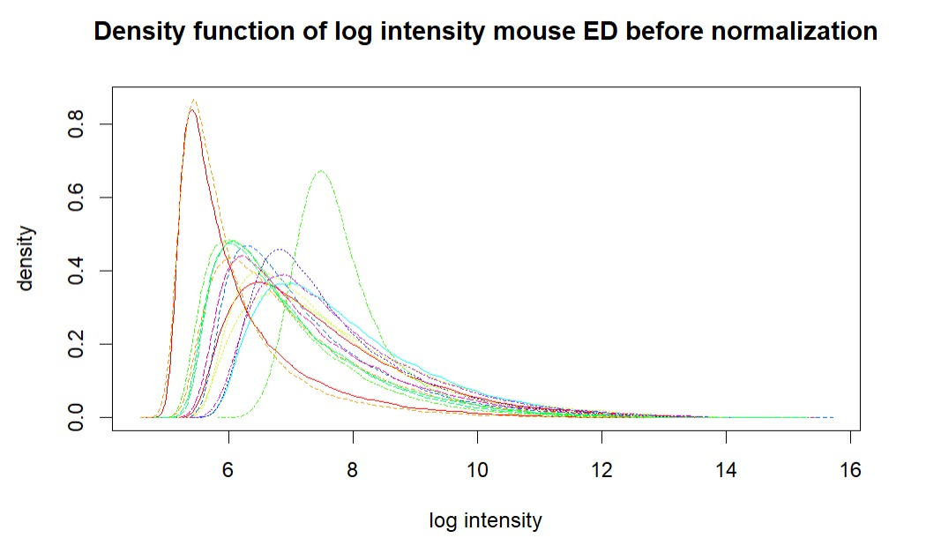
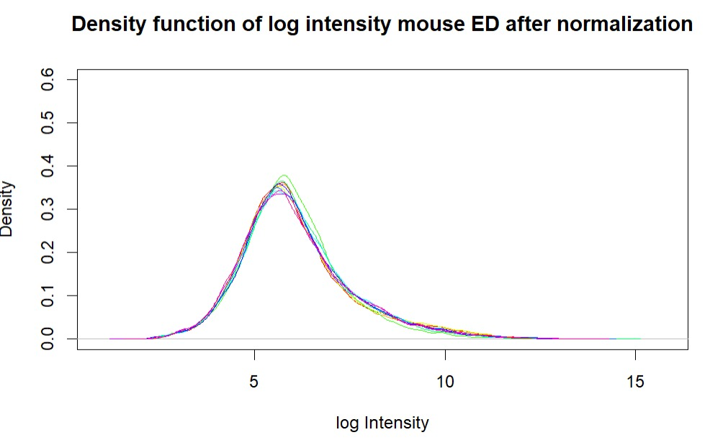
Quality control: Density plots

Slide 10
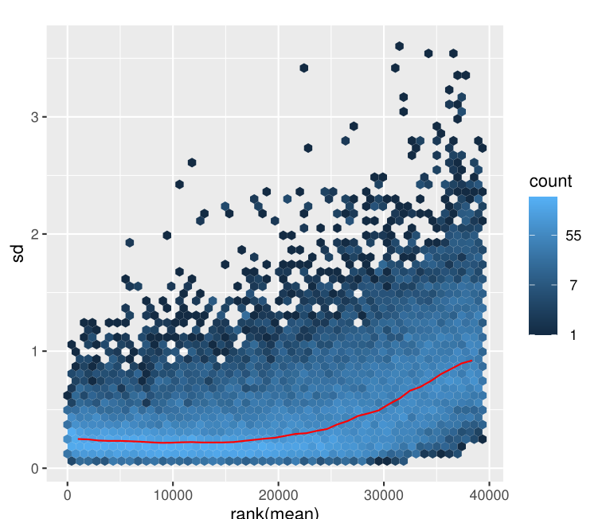
Quality control: meanSd-plot
standard deviation
rank(mean)

Slide 11
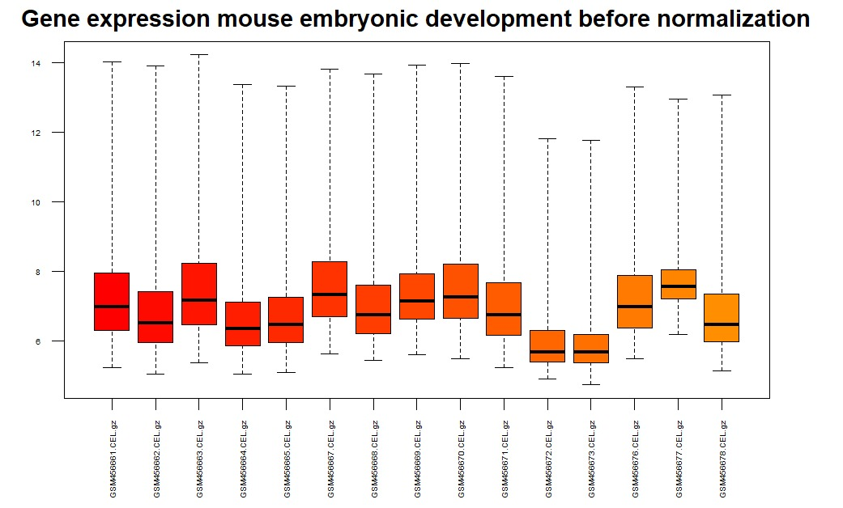
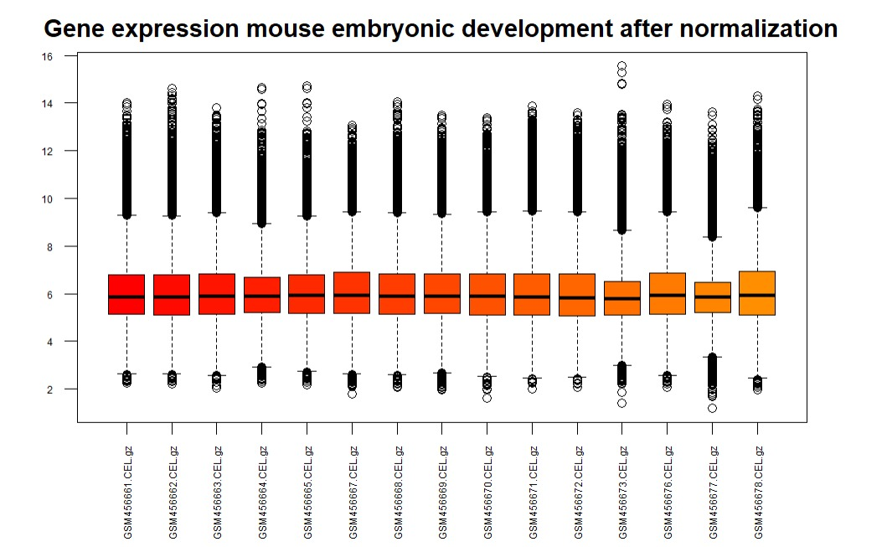
Quality control: Boxplot
Gene expression mouse embryonic development before normalization
Gene expression mouse embryonic development after normalization

Slide 12
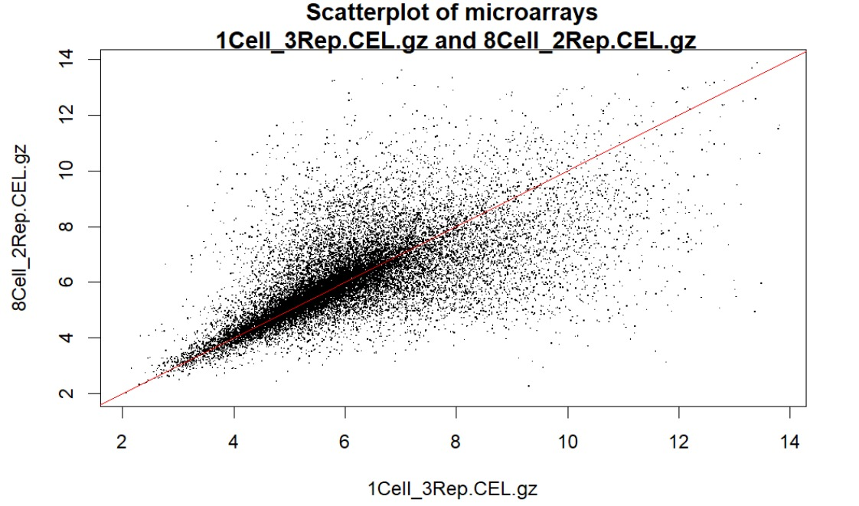
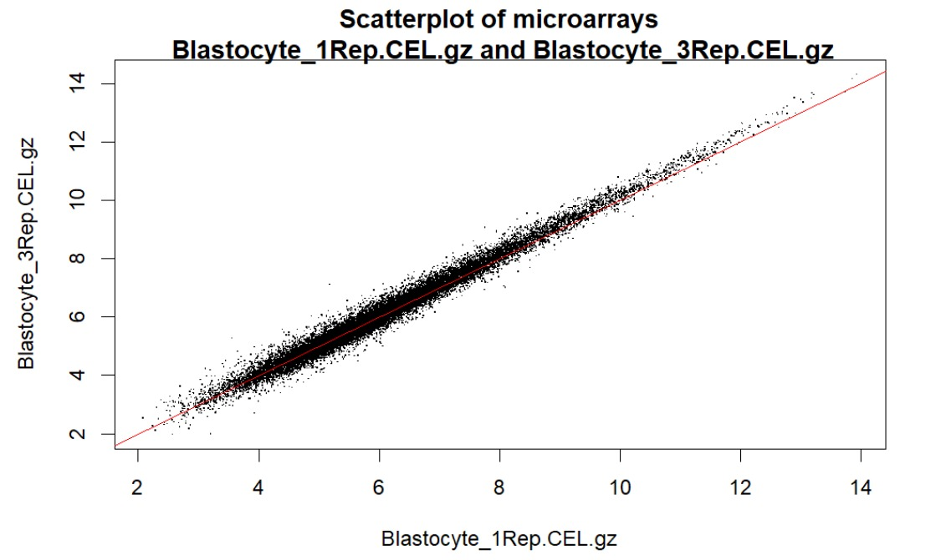
Quality control: Scatter plot

Slide 13

Thank you for your attention!
Notes:
Conclusion:

Slide 14
The Role of TRAs in Early Embryonic Development
Final project presentation
Group 4: Amena Elmaadawy, Mariam Hassan, Nina Droste, Aleksandra Dohren
Supervisors: Dr. Maria Dinkelacker, Ian Fichtner
Molecular Biotechnology B. Sc, Ruprecht Karls University of Heidelberg

Slide 15

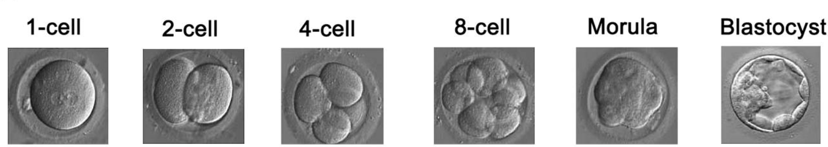
Preimplantation embryo development
Global transcriptional profiles of mammalian PED
We use preimplantation mouse data
cDNA collected on Affymetrix Gene Chips
Xie et al. 2010
Xie et al. 2010 ; Geisert, Spencer 2021

Slide 16

Introduction to TRAs
Tissue restricted antigens
Highly expressed by mTECs
Regulated by AIRE and Fezf2
establishment of central-self tolerance (negative selection)
Dinkelacker (2019); Takaba and Takanayagi (2017)

Slide 17
TRAs in specific context
TRA- Database by Dinkelacker 2007/2019
Highly and specifically expressed in certain tissues
" tissue-restricted if it exceeds 5x the median gene expression in at least one and not more than five tissues out of all tissues in the dataset"
Tissue-specificity is important for development of the three germ layers

Slide 18

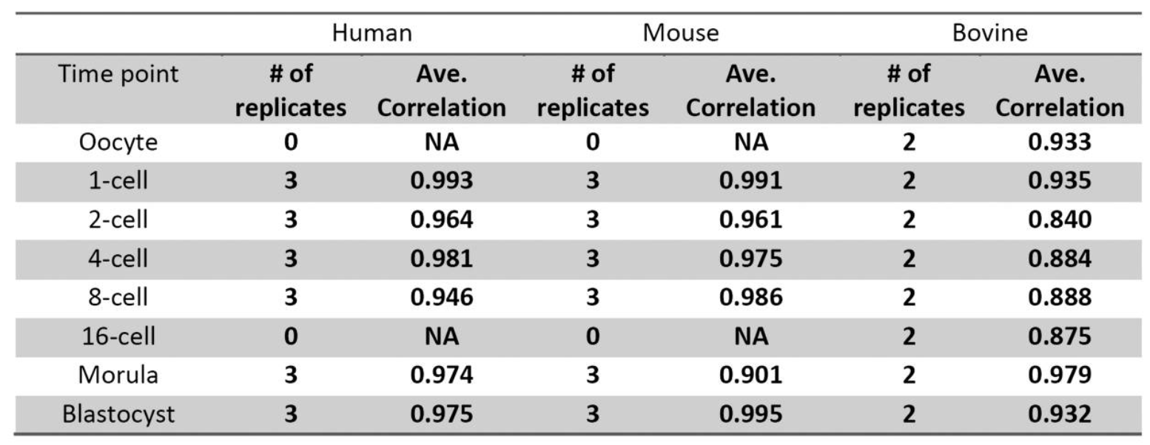
Our dataset
GSE18290; Xie et al. 2010 Affymetrix MOE430A
Xie et al. (2010) Rewirable gene regulatory networks in the preimplantation development of three mammalian species

Slide 19

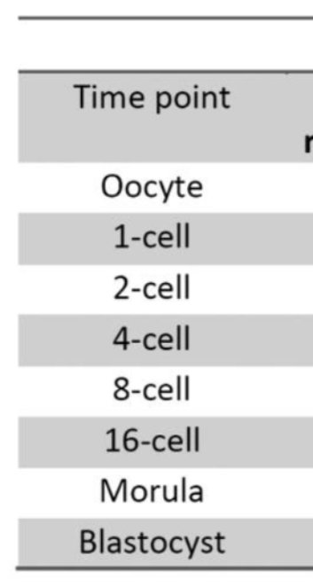
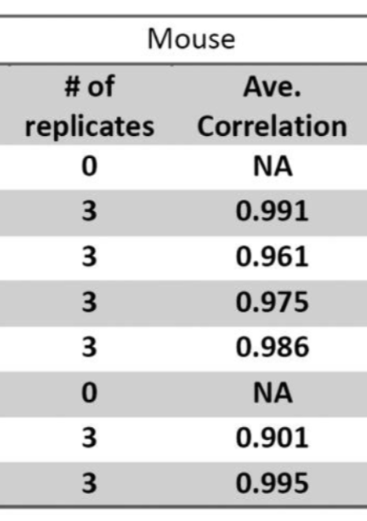
Our dataset
Rewiring of regulatory networks in PED PED
Largest changes of expression between four- and eight-cell stages
Xie et al. 2010
Xie et al. (2010) Rewirable gene regulatory networks in the preimplantation development of three mammalian species

Slide 20
Large changes in gene expression between four- and eight-cell stages are linked to the expression of TRAs and thus to tissue development
Notes:
True, 4-8 cell stage ist overregulated: DGE, unsignifikant unsignifikant sagt niht, dass es keine changes gibt.
Tissue development: Wir haben getestet GSEA 4/8/ all show HYPOXIA Pathways, and no tissue development pathways
There larges change in gene exressioen do not indicate tissue development. Therefore TRA expression is not mecessarly liked to tissue development

Slide 21
Sub questions
Is the greatest TRA expression found between the fourth and eighth cell stage?
Is TRA expression in bovine comparable to TRA expression in mouse?
Which is the earliest biological function expressed by those genes?
Notes:
Yes, we found that with DGE -> Graphen tabellen etc.
We dont have bovine TRA data sets to match but we compared pathways that are significant in either bovine or mouse and we didnt find matching ones. With given tra table bovine we are able to identify TRA Genes that are behaving similarly in both, mouse and bovine. More time and resou
We found pathways -> Hypoxia

Slide 22

Milestones
Choose data set
Quality control
Statistical tests, TRA determination in our data set
Code clean-up, markdown preparation, and finishing touches
1st week of May
1st- 2nd week of May
1st- 2nd week of June
3rd- 4th week of June
1st- 2nd week of May
3rd week of May
2nd- 3rd week of June
3rd week of July
Normalization of microarray data
Descriptive analysis
TRA determination, gene clustering
Prepare final presentation

Slide 23

What have we achived so far
Choose data set
Quality control
Statistical tests, TRA determination in our data set
Code clean-up, markdown preparation, and finishing touches
1st week of May
1st- 2nd week of May
1st- 2nd week of June
3rd- 4th week of June
1st- 2nd week of May
3rd week of May
2nd- 3rd week of June
3rd week of July
Normalization of microarray data
Descriptive analysis
TRA determination, gene clustering
Prepare final presentation

Slide 24
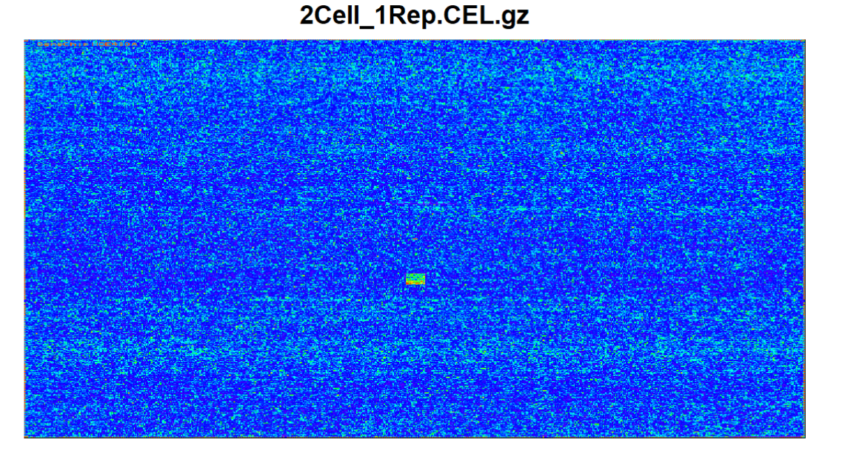
Quality control of chips: Single chip control

Slide 25
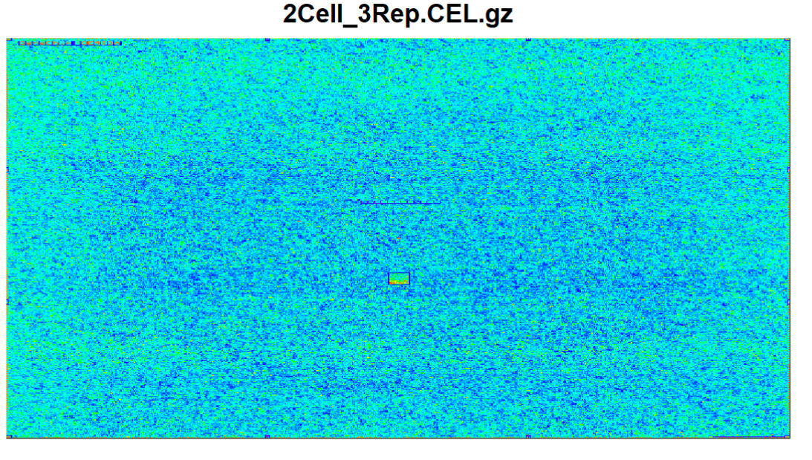
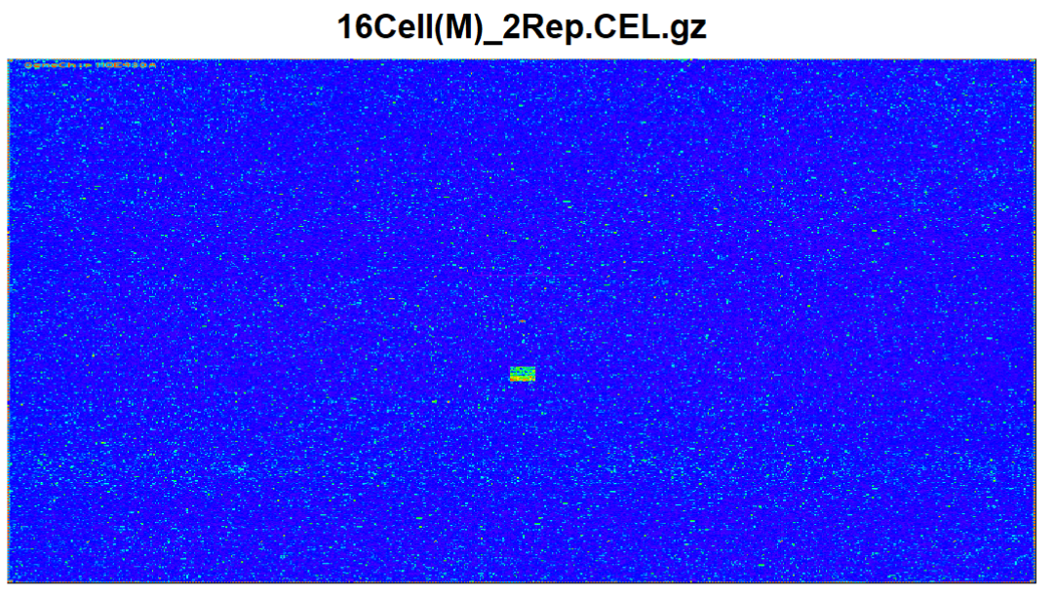
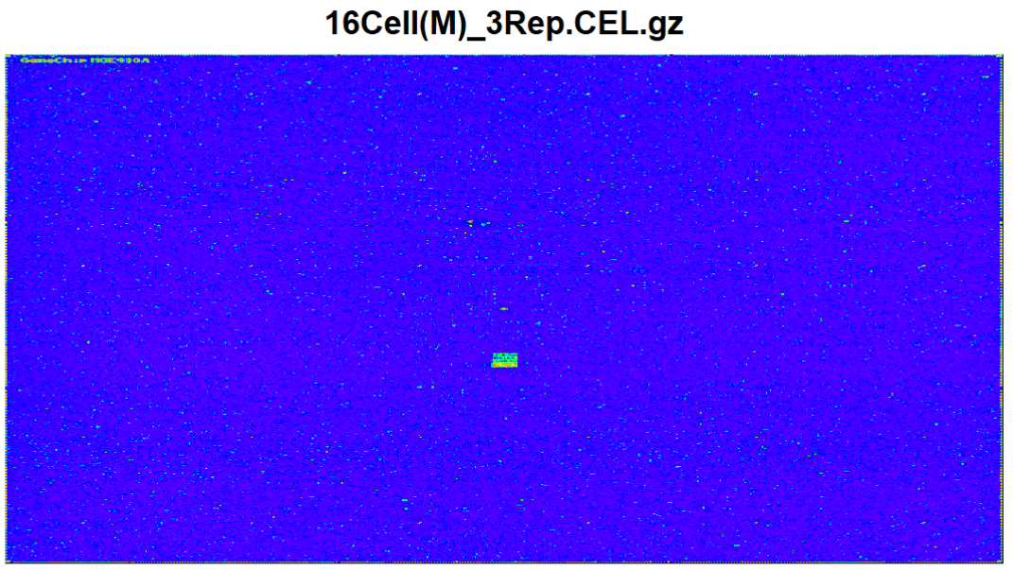
Excluded chips
Exclusion of over- and underexpressed chips

Slide 26
Quality control: RNA degradation

Slide 27
Quality control: Density plots

Slide 28
Quality control: meanSd-plot
standard deviation
rank(mean)

Slide 29
Quality control: Boxplot
Gene expression mouse embryonic development before normalization
Gene expression mouse embryonic development after normalization

Slide 30
Quality control: Scatter plot

Slide 31
Conclusion

Slide 32
Thank you for your attention!
Notes:
Conclusion:

